Slide 1




Notes:
In this presentation, we will explain how Selenium is used withn Provengo.

Slide 2
// @provengo summon selenium
const URL = 'https://demo.prestashop.com/#/en/login'
const SESSION = "customer-session"
user = {
email: 'bob.smith@prestashop.com',
password: 'bob.smith@prestashop.com'
}
bthread("", function () {
sync({ request: StartSession("my session", "chrome", [URL]) });
sync({ request: SwitchFrame("my session", ["//iframe[contains(@id,'framelive')]"]) })
sync({ request: WaitForVisibility("my session", ["//img[contains(@src,'logo.png')]"], 50000) });
sync({ request: Click("my session", ["//span[contains(.,'Sign in')]"]) })
sync({ request: WriteText("my session", ['//input[@id="field-email"]'], user.email, true) })
sync({ request: WriteText("my session", ['//input[@id="field-password"]'], user.password, true) })
sync({ request: Click("my session", ['//button[@id="submit-login"]']) })
})
Notes:
In Provengo, applying Selenium is done via triggering of events. In this example, we request a sequence of events for logging into a website.

Slide 3
// @provengo summon selenium
const URL = 'https://demo.prestashop.com/#/en/login'
const SESSION = "customer-session"
user = {
email: 'bob.smith@prestashop.com',
password: 'bob.smith@prestashop.com'
}
bthread("", function () {
sync({ request: StartSession("my session", "chrome", [URL]) });
sync({ request: SwitchFrame("my session", ["//iframe[contains(@id,'framelive')]"]) })
sync({ request: WaitForVisibility("my session", ["//img[contains(@src,'logo.png')]"], 50000) });
sync({ request: Click("my session", ["//span[contains(.,'Sign in')]"]) })
sync({ request: WriteText("my session", ['//input[@id="field-email"]'], user.email, true) })
sync({ request: WriteText("my session", ['//input[@id="field-password"]'], user.password, true) })
sync({ request: Click("my session", ['//button[@id="submit-login"]']) })
})
Notes:
Note that we need to summon the Selenium library when we use these events.

Slide 4
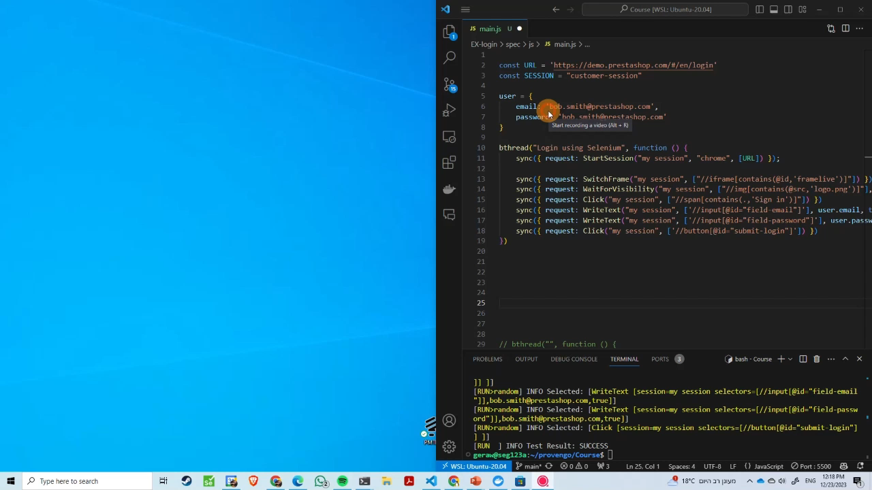
Notes:
When this model is executed in Provengo, the triggering of events is translated to actions that test the web site.

Slide 5
// @provengo summon selenium
const URL = 'https://demo.prestashop.com/#/en/login'
const SESSION = "customer-session"
user = {
email: 'bob.smith@prestashop.com',
password: 'bob.smith@prestashop.com'
}
bthread("", function () {
sync({ request: StartSession("my session", "chrome", [URL]) });
sync({ request: SwitchFrame("my session", ["//iframe[contains(@id,'framelive')]"]) })
sync({ request: WaitForVisibility("my session", ["//img[contains(@src,'logo.png')]"], 50000) });
sync({ request: Click("my session", ["//span[contains(.,'Sign in')]"]) })
sync({ request: WriteText("my session", ['//input[@id="field-email"]'], user.email, true) })
sync({ request: WriteText("my session", ['//input[@id="field-password"]'], user.password, true) })
sync({ request: Click("my session", ['//button[@id="submit-login"]']) })
})
Notes:
The first event we request is called ‘StartSession’. This initiates a browser session with a given name. Every event that follows will use the session’s name as a parameter. This setup lets us operate browser sessions concurrently, facilitating thorough testing that encompasses simultaneous activities.

Slide 6
// @provengo summon selenium
const URL = 'https://demo.prestashop.com/#/en/login'
const SESSION = "customer-session"
user = {
email: 'bob.smith@prestashop.com',
password: 'bob.smith@prestashop.com'
}
bthread("", function () {
sync({ request: StartSession("my session", "chrome", [URL]) });
sync({ request: SwitchFrame("my session", ["//iframe[contains(@id,'framelive')]"]) })
sync({ request: WaitForVisibility("my session", ["//img[contains(@src,'logo.png')]"], 50000) });
sync({ request: Click("my session", ["//span[contains(.,'Sign in')]"]) })
sync({ request: WriteText("my session", ['//input[@id="field-email"]'], user.email, true) })
sync({ request: WriteText("my session", ['//input[@id="field-password"]'], user.password, true) })
sync({ request: Click("my session", ['//button[@id="submit-login"]']) })
})
Notes:
The second parameter to the Selenium events is a list of selectors, xpaths, that identify an object on page.

Slide 7
// @provengo summon selenium
const URL = 'https://demo.prestashop.com/#/en/login'
const SESSION = "customer-session"
user = {
email: 'bob.smith@prestashop.com',
password: 'bob.smith@prestashop.com'
}
bthread("", function () {
sync({ request: StartSession("my session", "chrome", [URL]) });
sync({ request: SwitchFrame("my session", ["//iframe[contains(@id,'framelive')]"]) })
sync({ request: WaitForVisibility("my session", ["//img[contains(@src,'logo.png')]"], 50000) });
sync({ request: Click("my session", ["//span[contains(.,'Sign in')]"]) })
sync({ request: WriteText("my session", ['//input[@id="field-email"]'], user.email, true) })
sync({ request: WriteText("my session", ['//input[@id="field-password"]'], user.password, true) })
sync({ request: Click("my session", ['//button[@id="submit-login"]']) })
})
Notes:
The rest of the parameters are specific to the events. For example, the number 50000 is the time we want to wait for visibility of the object, and the text user.email is what we want to write in the text box.

Slide 8
bthread("", function () {
sync({ request: StartSession("my session", "chrome", [URL]) });
sync({ request: SwitchFrame("my session", ["//iframe[contains(@id,'framelive')]"]) })
sync({ request: WaitForVisibility("my session", ["//img[contains(@src,'logo.png')]"], 50000) });
sync({ request: Click("my session", ["//span[contains(.,'Sign in')]"]) })
sync({ request: WriteText("my session", ['//input[@id="field-email"]'], user.email, true) })
sync({ request: WriteText("my session", ['//input[@id="field-password"]'], user.password, true) })
sync({ request: Click("my session", ['//button[@id="submit-login"]']) })
})
Same Same
bthread("", function () {
with (new SeleniumSession().start(URL)) {
switchFrame("//iframe[contains(@id,'framelive')]")
waitForVisibility("//img[contains(@src,'logo')]", 50000)
click("//span[contains(.,'Sign in')]")
writeText('//input[@id="field-email"]', user.email)
writeText('//input[@id="field-password"]', user.password)
click('//button[@id="submit-login"]')
}
})
Notes:
To simplify model development, Provengo provides a session object. This object provides methods that issue event requests without calling the sync function directly. These methods are convenient wrappers that allow standard automation scripts.

Slide 9
Notes:
This brings our lesson to a close. We’ve successfully mastered the use of Provengo to initiate Selenium events for website testing.

